Slide 1
18PYB103J
SEMICONDUCTOR PHYSICS
UNIT 5
Fabrication Technique
CVD and PVD
Lecture 8

Slide 2
Chemical Vapour Deposition
  Chemical vapour deposition or CVD is a generic name for a group of processes that involve depositing a solid material from a gaseous phase.
  Microfabrication processes widely use CVD to deposit materials in various forms, including: monocrystalline, polycrystalline, amorphous, and epitaxial.
  These materials include: silicon, carbon fiber, carbon nanofibers, filaments, carbon nanotubes, SiO2, silicon-germanium, tungsten, silicon carbide, silicon nitride, silicon oxynitride and titanium nitride.
  CVD process is also used to produce synthetic diamonds.

Slide 3
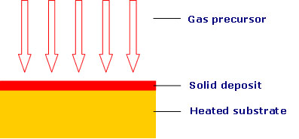
CVD REACTION

Slide 4
Working Concept
Chemical vapor deposition (CVD) results from the chemical reaction of gaseous precursor(s) at a heated substrate to yield a fully dense deposit.
Metal deposition
metal halide (g) → metal(s) + byproduct (g)
Ceramic deposition
metal halide (g) + oxygen/carbon/nitrogen/boron source (g) → ceramic(s) + byproduct (g)
g- gas; s-solid

Slide 5
A basic CVD process consists of the following steps:
a predefined mix of reactant gases and diluent inert gases are introduced at a specified flow rate into the reaction chamber;
the gas species move to the substrate;
the reactants get adsorbed on the surface of the substrate;
the reactants undergo chemical reactions with the substrate to form the film; and
the gaseous by-products of the reactions are desorbed and evacuated from the reaction chamber.

Slide 6
Reactions that take place at the substrate surface are known as heterogeneous reactions, and are selectively occurring on the heated surface of the wafer where they create good-quality films.
Homogeneous reactions form gas phase aggregates of the depositing material, which adhere to the surface poorly and at the same time form low-density films with lots of defects.
In short, heterogeneous reactions are much more desirable than homogeneous reactions during chemical vapor deposition.

Slide 7
Types of chemical vapor deposition
For instance, a reactor is said to be 'hot-wall' if it uses a heating system that heats up not only the wafer, but the walls of the reactor itself.
'Cold-wall' reactors use heating systems that minimize the heating up of the reactor walls while the wafer is being heated up.
In hot-wall reactors, films are deposited on the walls in much the same way as they are deposited on wafers.
so this type of reactor requires frequent wall cleaning.

Slide 8
Atmospheric pressure CVD (APCVD) reactors operate at atmospheric pressure, and are therefore the simplest in design.
Low-pressure CVD (LPCVD) reactors operate at medium vacuum (30-250 Pa) and higher temperature than APCVD reactors.
Plasma Enhanced CVD (PECVD) reactors also operate under low pressure, but do not depend completely on thermal energy to accelerate the reaction processes.
They also transfer energy to the reactant gases by using an RF-induced glow discharge.

Slide 9
Advantages of CVD
Can be used for a wide range of metals and ceramics
Fabricates net or near-net complex shapes
Is self-cleaning—extremely high purity deposits (>99.995% purity)
Has controllable thickness and morphology
Forms alloys
Infiltrates fiber preforms and foam structures
Can simultaneously coat multiple components
Coats powders

Slide 10
Applications
CVD processes are used on a surprisingly wide range of industrial components, from aircraft and land gas turbine blades, timing chain pins for the automotive industry, radiant grills for gas cookers and items of chemical plant, to resist various attacks by carbon, oxygen and sulphur.
Surface modification to prevent or promote adhesion
MEMS coating to reduce stiction
BioMEMS and biosensor coating to reduce "drift" in device performance

Slide 11
Physical Vapour Deposition(PVD)
Physical vapour deposition (PVD) is fundamentally a vaporisation coating technique, involving transfer of material on an atomic level.
The process is similar to chemical vapour deposition (CVD) except that the raw materials/precursors

Slide 12
Working Concept
PVD processes are carried out under vacuum conditions. The process involved four steps:
1.Evaporation
2.Transportation
3.Reaction
4.Deposition

Slide 13
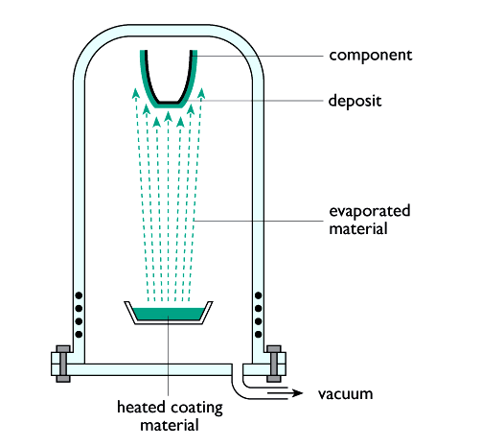
The vacuum evaporation PVD process

Slide 14
Variants of PVD include, in order of increasing novelty:
Evaporative Deposition: In which the material to be deposited is heated to a high vapor pressure by electrically resistive heating in "high" vacuum.
Electron Beam Physical Vapor Deposition: In which the material to be deposited is heated to a high vapor pressure by electron bombardment in "high" vacuum.
Sputter Deposition: In which a glow plasma discharge bombards the material sputtering some away as a vapor.
Cathodic Arc Deposition: In which a high power arc directed at the target material blasts away some into a vapor.
Pulsed Laser Deposition: In which a high power laser ablates material from the target into a vapor.

Slide 15
Advantages
Materials can be deposited with improved properties compared to the substrate material
Almost any type of inorganic material can be used as well as some kinds of organic materials
The process is more environmentally friendly than processes such as electroplating
Disadvantages
High capital cost
Some processes operate at high vacuums and temperatures requiring skilled operators
Processes requiring large amounts of heat require appropriate cooling systems
The rate of coating deposition is usually quite slow

Slide 16
Applications
PVD coatings are generally used to improve hardness, wear resistance and oxidation resistance.
Thus, such coatings use in a wide range of applications such as:
Aerospace
Automotive
Surgical/Medical
Dies and moulds for all manner of material processing
Cutting tools
Fire arms <number><number>

